Slide 1
THE EASTERN AFRICA ASSOCIATION
Members’ Survey, June 2021:
Opportunities and Risks in the Region

Slide 2
Which of the following best describes the principal industry of your organization?

Slide 3
How many employees do you have in the region?

Slide 4
How many countries in Eastern Africa are you invested in?

Slide 5
Will your business and investment increase or not over next 24 months?

Slide 6
In the next 24 months where do you expect to invest?

Slide 7
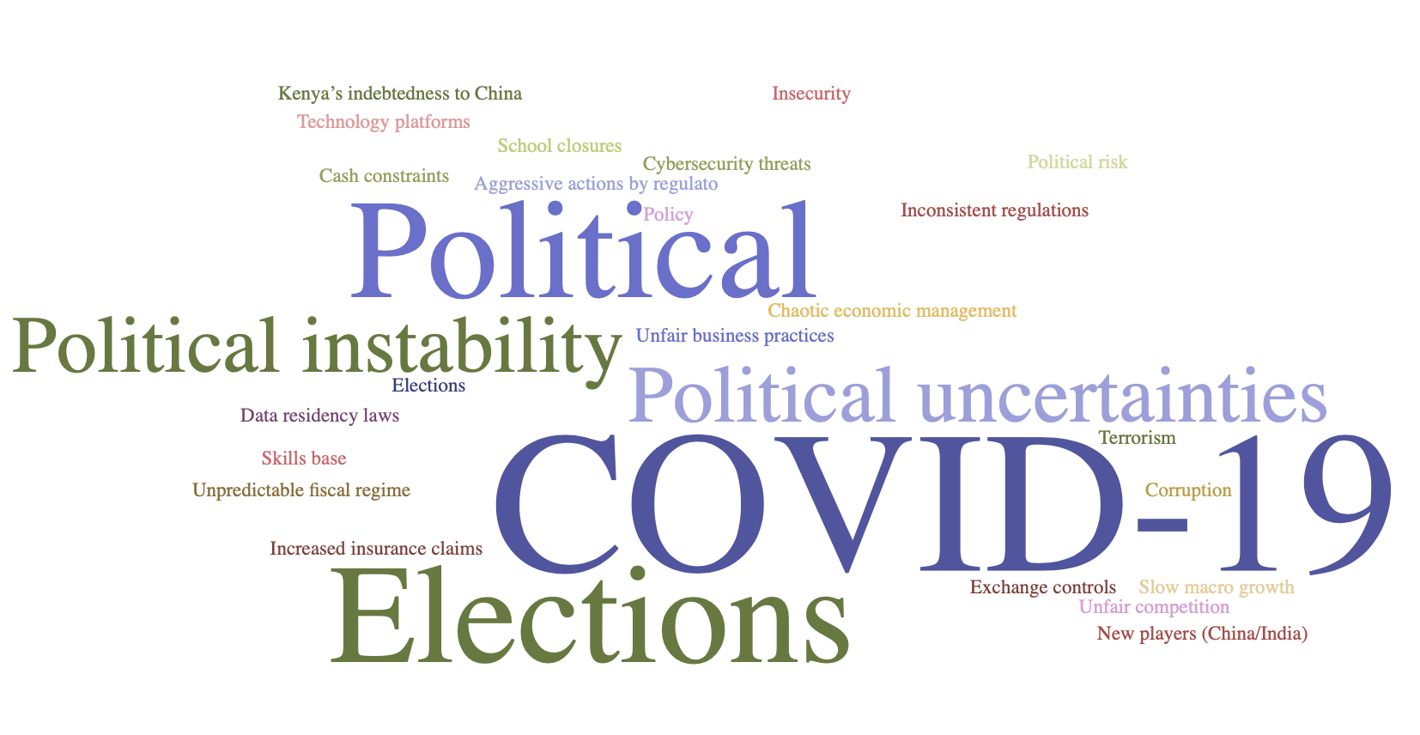
What do you see as the biggest risk(s) for your business in the region?

Slide 8
Risks in the region

Slide 9
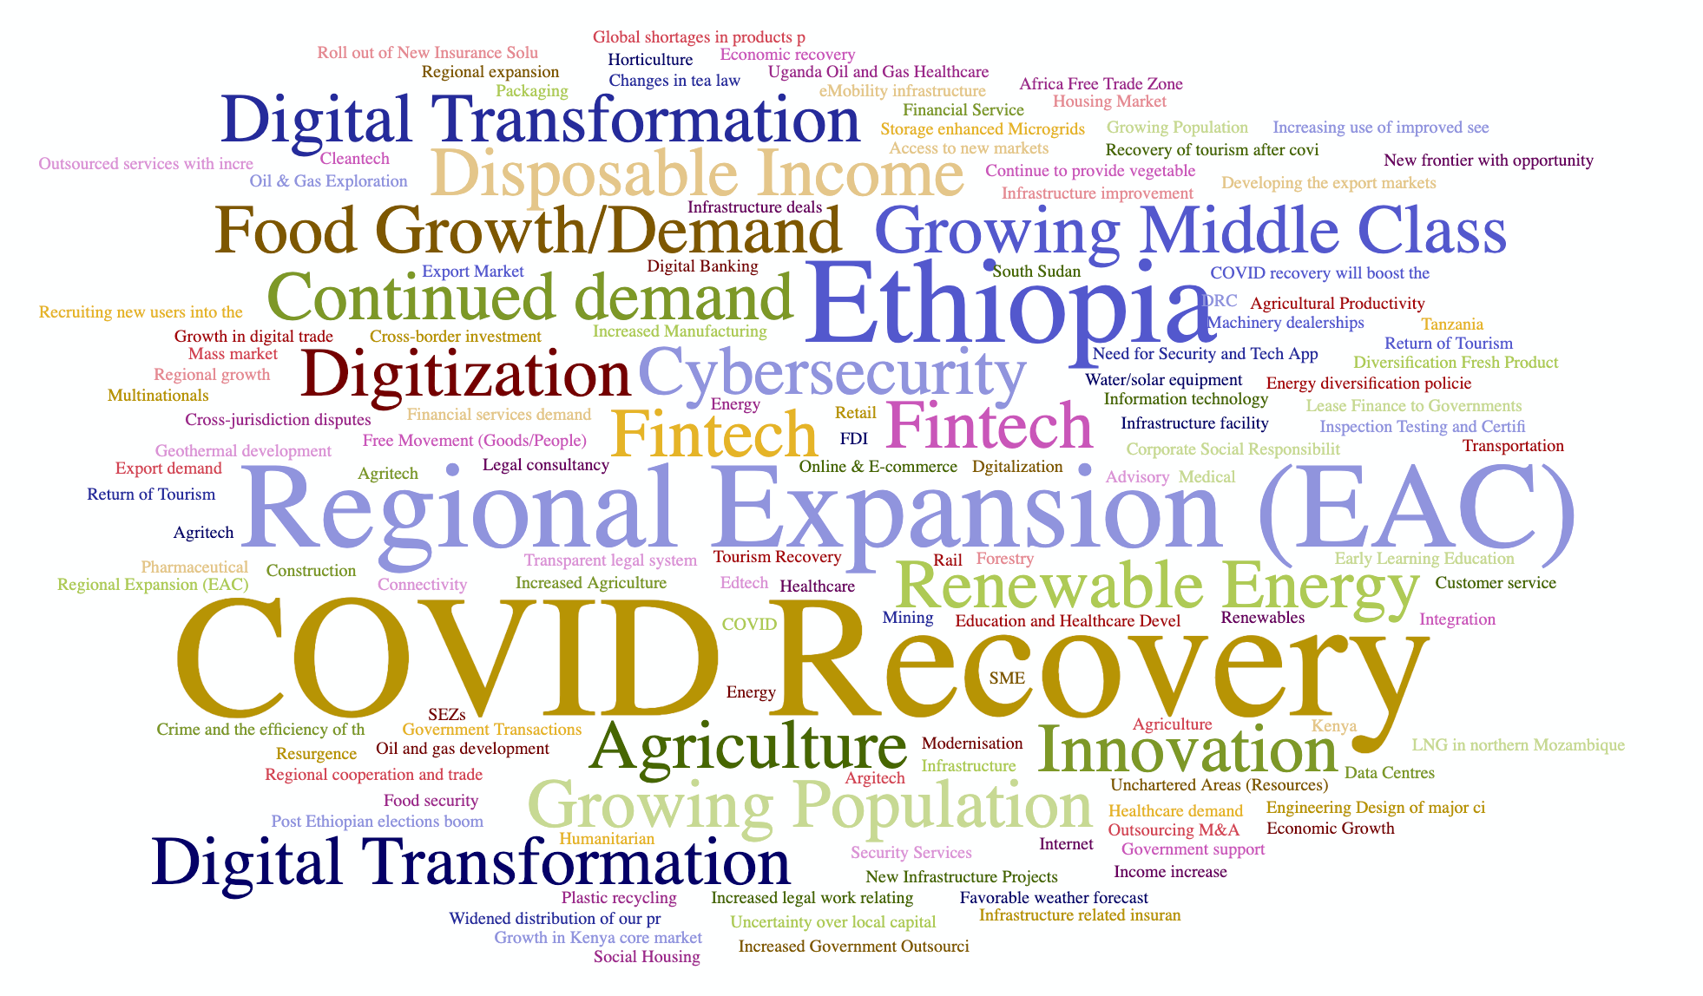
What do you see as the biggest opportunity (or opportunities) for your business in the region?

Slide 10
Opportunities in the region

